Slide 1
LeafletJS
Scott Beslow

Slide 2
What is LeafletJS?
Open source Javascript library for interactive maps
Plugins - geography with JS
Work with maps, but doesn’t provide them
Including Google Maps, ESRI, and MapBox
Adding a map to a webpage is easy!

Slide 3
What Neighborhood
Am I In?
http://sbeslow.github.io/chiNeighborhood

Slide 4
The Building Blocks
What Neighborhood Am I In?
Location of the user
Geography of the neighborhoods
Visualize
Draw a zoomed in map with neighborhood marked, put the marker on the map

Slide 5
Create basic HTML
<html>
…
include leaflet, leaflet-pip
<div id=”mymap”></div>
…
</html>

Slide 6
Draw the map
var mymap = L.map('mapid').setView([41.878476, -87.633044], 11.08);
L.tileLayer('https://api.mapbox.com/styles/v1/scottbeslow/ciy1z57zk00622sp6ymognxvk/tiles/256/{z}/{x}/{y}?access_token=<access_token_from_mapbox>{
attribution: 'Map data &copy; <a href="http://openstreetmap.org">OpenStreetMap</a> contributors,
<a href="http://creativecommons.org/licenses/by-sa/2.0/">CC-BY-SA</a>,
Imagery © <a href="http://mapbox.com">Mapbox</a>',
}).addTo(mymap);

Slide 7
Locate User Position
mymap.locate({
setView: true,
maxZoom: 16
})
.on('locationfound', function (e) {
L.circle(e.latlng, radius).addTo(mymap);
currentLatLng = e.latlng;
})

Slide 8
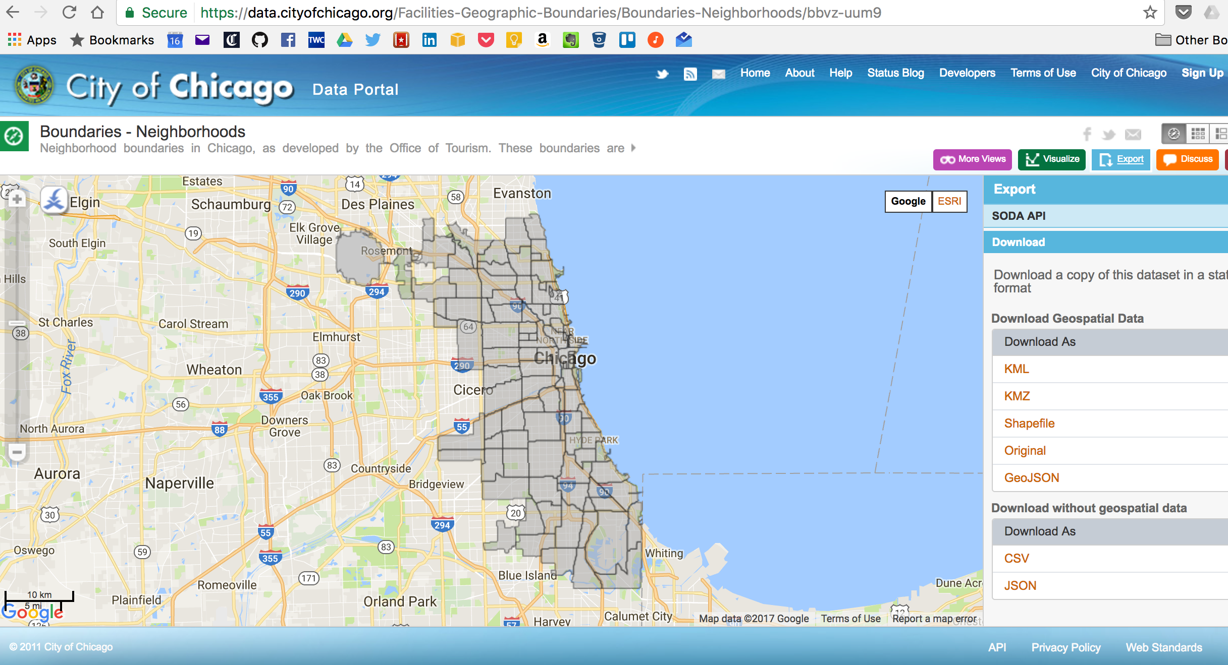

Slide 9
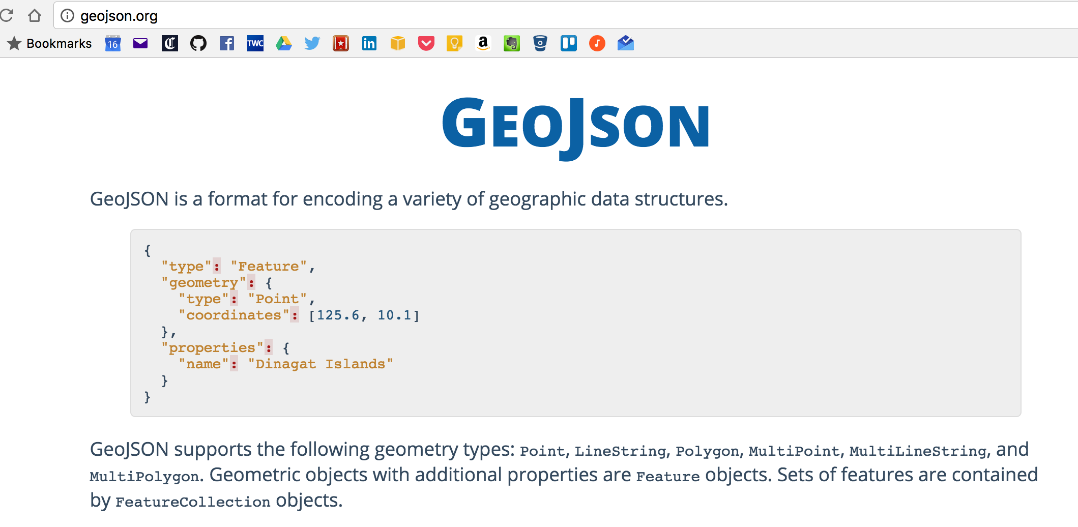

Slide 10
Get the neighborhood boundaries
$.getJSON("chiBoundaries.geojson", function (chiBoundariesJson) {
geoJsonLayer = L.geoJSON(chiBoundariesJson, {
onEachFeature: onEachFeature
}).addTo(mymap);
});
function onEachFeature(feature, layer) {
L.marker(layer.getBounds().getCenter(), {
icon: L.divIcon({className: 'label',
html: '<i style="color: red;">' + feature.properties.community + '</i>',
iconSize: [100, 40]
})
}).addTo(mymap);
}

Slide 11
leaflet-pip
var results = leafletPip.pointInLayer(latLong, geoJsonLayer);
if (results.length == 0) {
alert("Sorry, can't find you. Are you even in Chicago?");
}
var name = toTitleCase(results[0]['feature']['properties']['community']);
$("#neighborhoodName").html("You are in " + name);
L.marker(currentLatLng, {...}).addTo(mymap);

Slide 12
Now What?
http://leafletjs.com
http://www.github.com/sbeslow/chiNeighborhood
http://data.cityofchicago.org
http://www.highcharts.com/maps/demo
http://wnaii.com

Slide 14
Pushing to GitHub
git checkout --orphan gh-pages

